Slide 1
Centrality with Diversity
Liang Lyu, Brandon Fain, Kamesh Munagala, Kangning Wang
Duke University
Notes:
Hi everyone, my name is Liang Lyu. Today I’ll be presenting our paper on centrality with diversity.

Slide 2
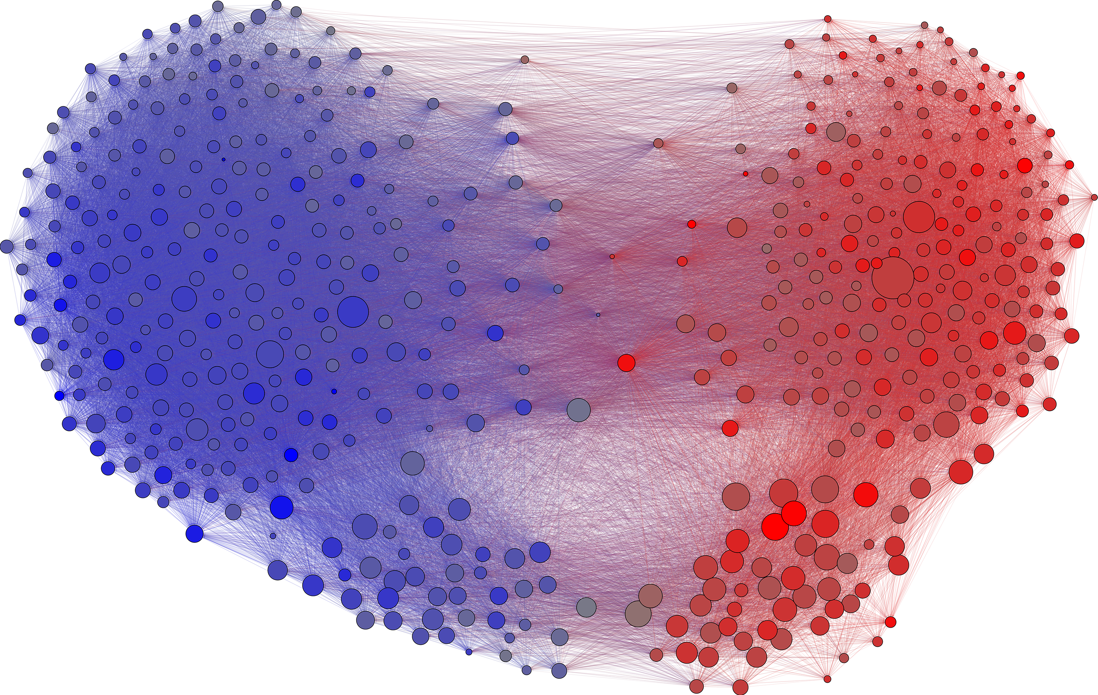
Motivation
Standard centrality: Which nodes are important in a homogeneous graph?
Diverse centrality: Which nodes are simultaneously “important” to multiple diverse communities within a heterogeneous graph?
Notes:
The motivation of our project is to combine the ideas of fairness and diversity with the standard problem of graph centrality.
Standard centrality: Homogeneous
Congress: Identify important Congress members who are connected to a large number of Congresspersons that are also important
Communities: Define D&R, each member has a certain degree of affiliation to both communities based on their partisanship and political beliefs
Simultaneously important to both Democrats and Republicans

Slide 3


Motivation – Communities
Political ideologies
Academic Fields
Demographic Groups
Notes:
Here are some more examples to illustrate why community structure and diverse centrality matter in networks.
Academic fields: CS, Math, Art, History, Political Science etc – authors and papers that lead important interdisciplinary work, encourages collaboration between disciplines
Demographic groups: Race, gender – individuals that are central to many different groups simultaneously, including both majority and minority groups

Slide 4
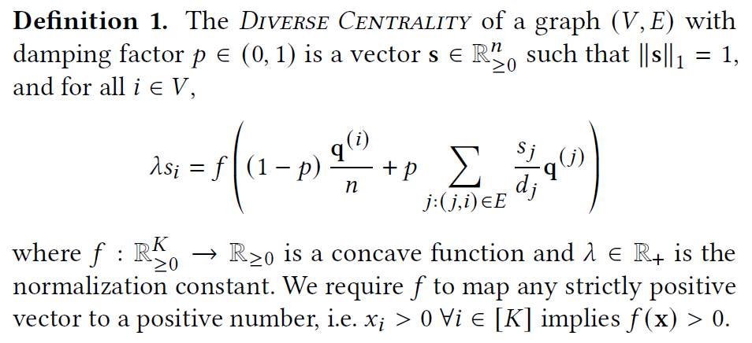
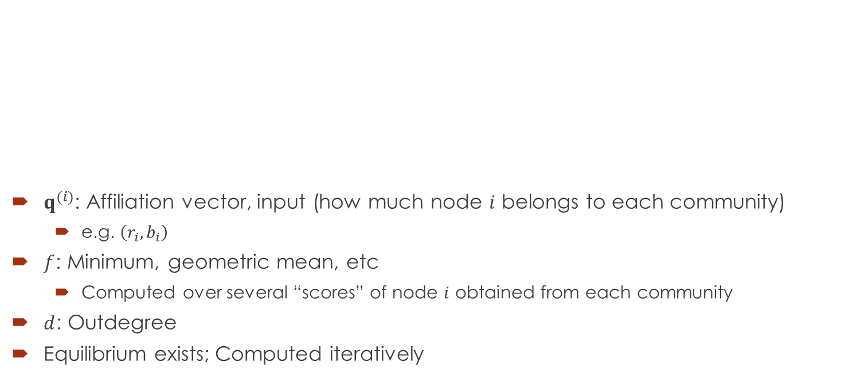
Diverse Centrality
scores from neighbors
$q^{(i)}$: Affiliation vector, input (how much node $i$ belongs to each community)
e.g. $\left(r_{i},b_{i}\right)$
$f$: Minimum, geometric mean, etc
Computed over several “scores” of node $i$ obtained from each community
$d$: Outdegree
Equilibrium exists; Computed iteratively
damping term
Notes:
Based on this setting of centrality in a heterogeneous graph, we propose our own DC measure.
Resemblance to PR: If s_i is the score of node I, it’s determined by two terms: damping term & a summation of scores from its neighbors
Both terms are vectors: Multiples of q_i and q_j – affiliation vectors (q_i: node I’s affiliation with all communities)
Sum within f(): “Score from each community”
F: Concave function that combines the scores from all communities, e.g. min, geometric mean
Preferring divesity
Balanced scores from all communities – higher overall score

Slide 5
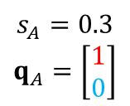
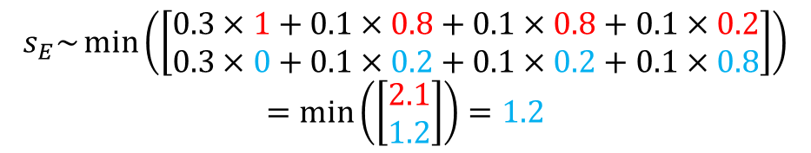
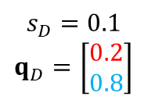
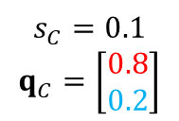
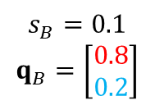
Example
$$s_{A}=0.3$$
$$q_{A}=\left[\begin{aligned}1 \\ 0\end{aligned}\right]$$
$$s_{B}=0.1$$
$$q_{B}=\left[\begin{aligned}0.8 \\ 0.2\end{aligned}\right]$$
$$s_{C}=0.1$$
$$q_{C}=\left[\begin{aligned}0.8 \\ 0.2\end{aligned}\right]$$
$$s_{D}=0.1$$
$$q_{D}=\left[\begin{aligned}0.2 \\ 0.8\end{aligned}\right]$$
A
B
C
D
E
$$s_{E}\sim \min\left(\left[\begin{aligned}0.3×1+0.1×0.8+0.1×0.8+0.1×0.2 \\ 0.3×0+0.1×0.2+0.1×0.2+0.1×0.8\end{aligned}\right]\right)$$
$$=\min\left(\left[\begin{aligned}2.1 \\ 1.2\end{aligned}\right]\right)=1.2$$
Notes:
Suppose f is min function. Score of E will be proportional to the minimum of two scores: “red score” and “blue score”
Weighted by ABCD’s scores (.3, .1) and their community affiliations (1, 0.8, 0.2)
The community with the lowest score (blue) determines final score of E

Slide 6
Desiderata / Normative Properties
We propose a diverse centrality measure should correlate with:
Centrality
Local Polarity
Neighborhood Polarity
Baseline algorithms:
PageRank
PageRank, reweighted by node polarity
PageRank, reweighted by neighborhood polarity
Notes:
Now, when we designed the DC measure, we proposed several normative properties that we think such a measure should satisfy.
Baselines: PageRank and simple reweighting models that rescale PR by certain properties

Slide 7
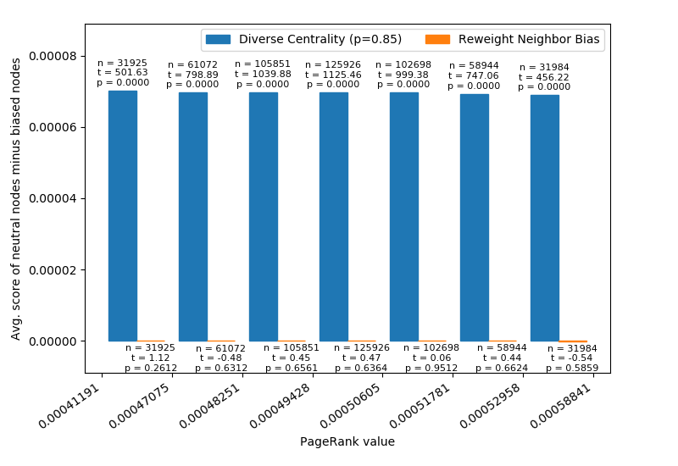
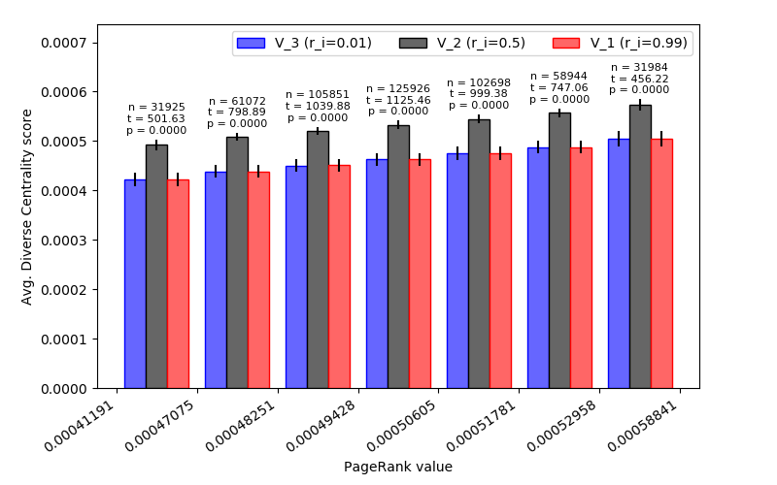
Synthetic Graphs – Local Polarity
Fixed: Centrality, Neighborhood Polarity
Varying: Local Polarity
Average Diverse Centrality scores
Balanced nodes minus Polarized nodes
Notes:
In a nutshell, we created certain synthetic graphs that contain a subset of nodes. These nodes differ from each other in terms of one of the three normative properties but the other two are kept constant.
- This graph: A subset of nodes have similar centrality and neighborhood polarity, but different local polarities

Slide 8
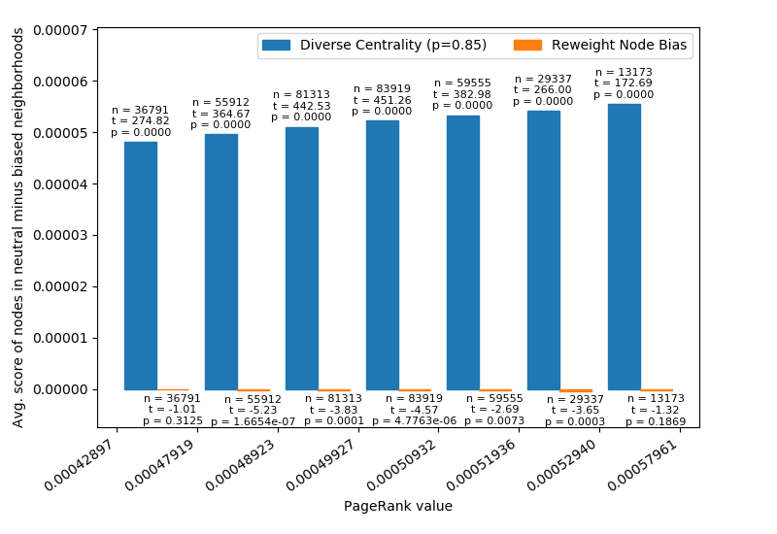
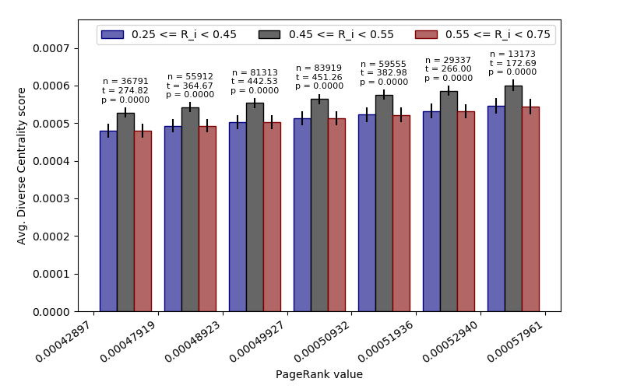
Synthetic Graphs – Neighborhood Polarity
Fixed: Centrality, Local Polarity
Varying: Neighborhood Polarity
Average Diverse Centrality scores
Balanced nodes minus Polarized nodes

Slide 9
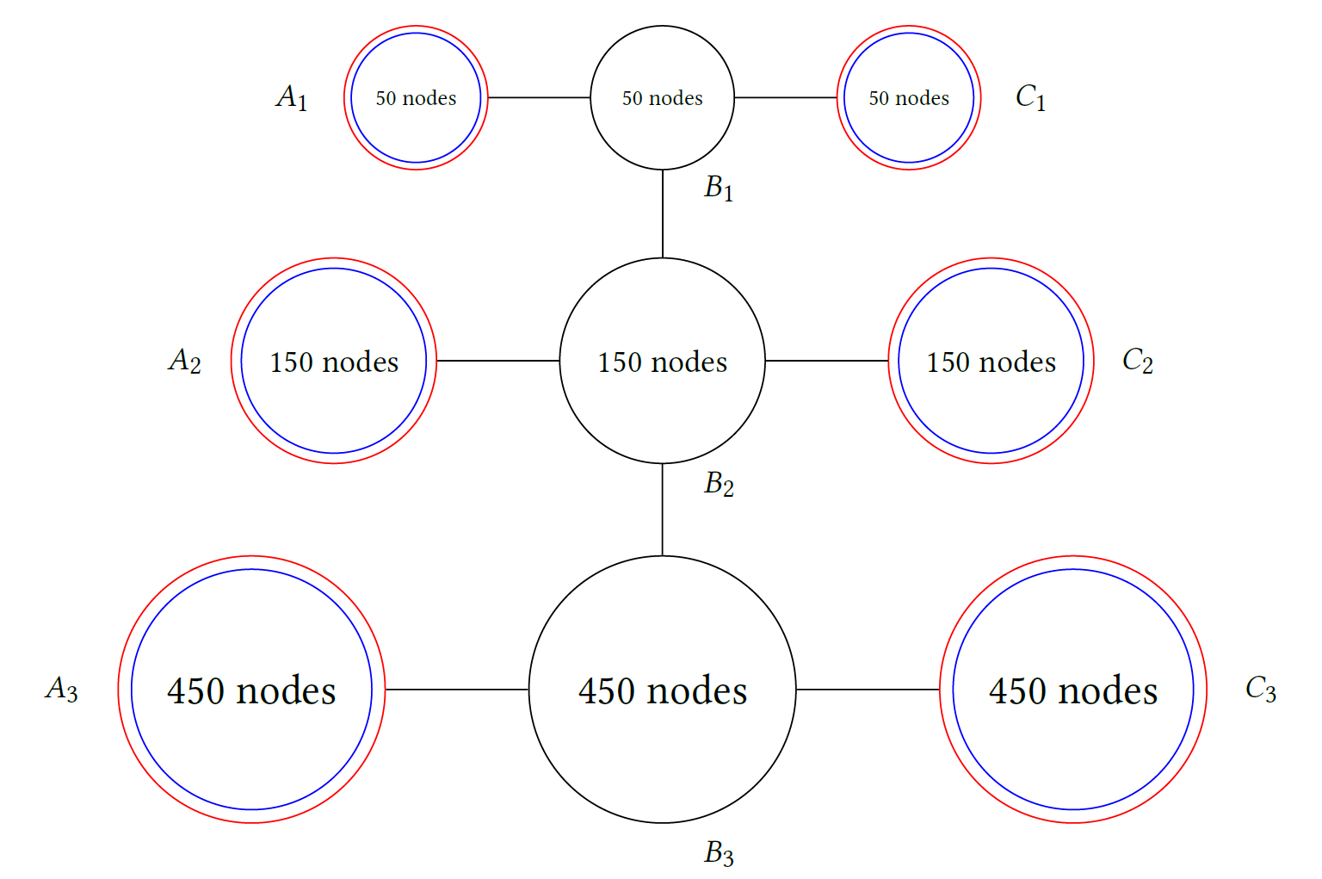
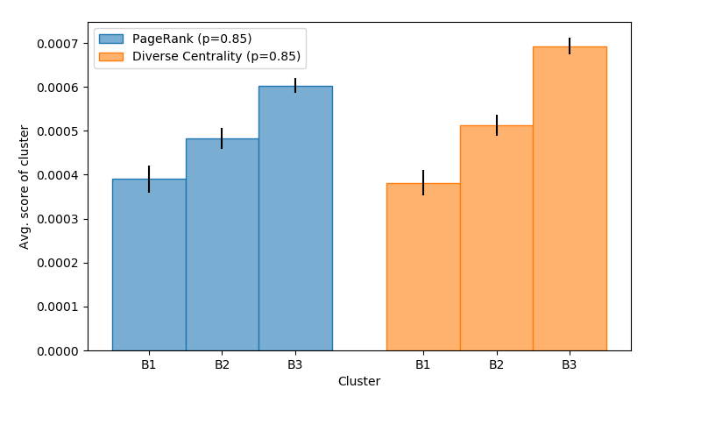
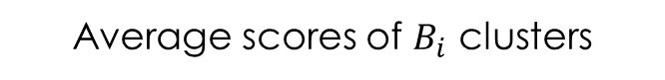
Synthetic Graphs – Centrality
Fixed: Local Polarity, Neighborhood Polarity
Varying: Centrality
Average scores of $B_{i}$ clusters

Slide 10
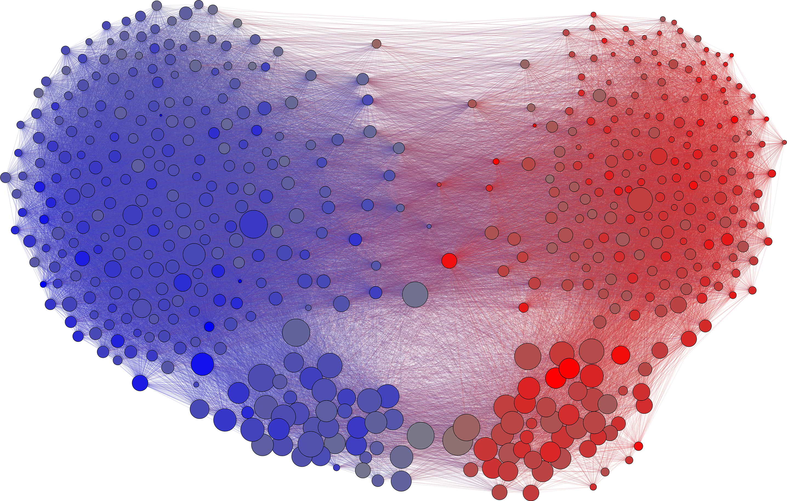
Congress (Twitter) Graph
House
Senate
PageRank scores
Diverse Centrality scores
Notes:
Perhaps one of the most interesting parts: Applying our DC measure to real-world graphs.
Edges: Twitter followerships
Polarities (community affiliation): DW-NOMINATE procedure – measures ideologies based on voting behavior
Congress: Two natural clusters, Democrats and Republicans
Each party has two subclusters: TL,TR house, BL,BR senate
Perhaps unsurprising that Senators are generally ranked more important by both measures
Senators receive much higher scores from DC than from PR

Slide 11
Congress (Twitter) Graph
PageRank scores
Diverse Centrality scores
Notes:
To understand why that happens, we need to take a closer look at graph structure:
Most edges fall under three categories:
Edges between Democratic House or Reps and Democratic Senators
Senators are generally well-connected to each other regardless of partisanship
Rep Senate – Rep House
Connections from a Democratic Rep to a Republical Rep typically goes through D Senate and R Senate
Both senate clusters are “bridging” the two different communities

Slide 12
“Bridge effect”
The Diverse Centrality model favors nodes that are not only bipartisan and influential (in terms of PageRank), but that also serve as a bridge to similarly bipartisan and influential nodes in other communities.

Slide 13
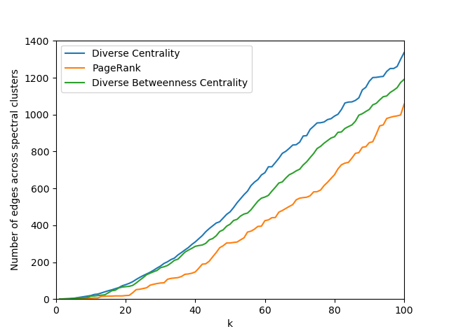
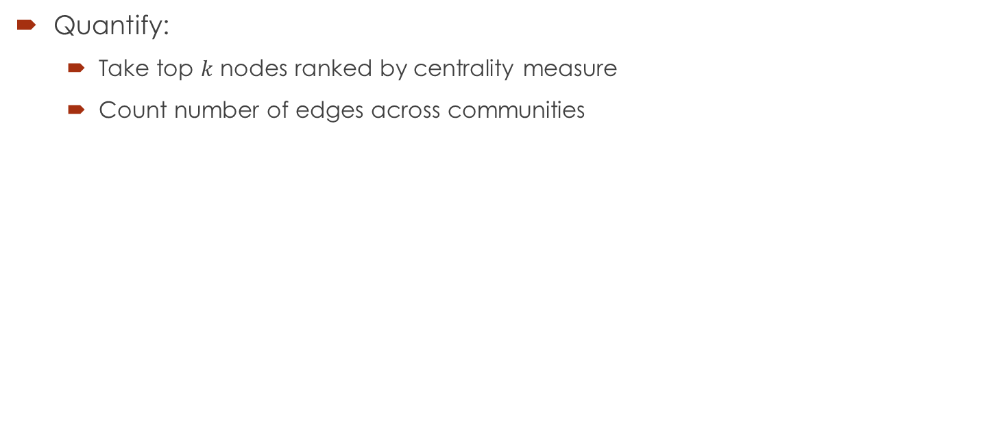
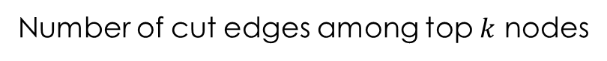
“Bridge effect”
Quantify:
Take top $k$ nodes ranked by centrality measure
Count number of edges across communities
Number of cut edges among top $k$ nodes
Notes:
We can quantify the bridge effect using a simple experiment
Fix a number k (40)
Pick the top 40 nodes ranked by DC
Some are D, some are R
Count how many of these remaining edges are from D to R, across the two communities (“cut edges”)
As you can see here, for all values of k, DC has a higher number of cut edges than PR and DBC
The top nodes ranked by DC have greater connectivity across multiple communities
OTOH, top nodes by PR are typically central nodes within a community but not well connected to other communities

Slide 14
Summary
Centrality on heterogeneous graphs
Diverse Centrality measure
Normative properties
Real-world graphs

Slide 15
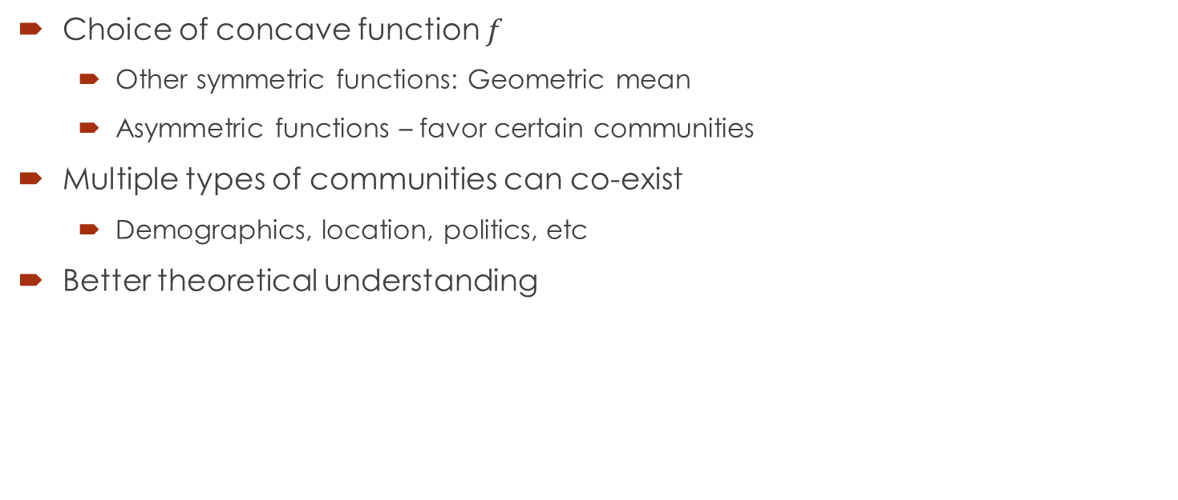
Open Questions
Choice of concave function $f$
Other symmetric functions: Geometric mean
Asymmetric functions – favor certain communities
Multiple types of communities can co-exist
Demographics, location, politics, etc
Better theoretical understanding
Notes:
Choice of f: Mostly considered minimum
Symmetric: Views all communities as equal, but different ways of combining scores from all communities
Asymmetric: Value a particular community as more important than others, e.g. protected groups/minority groups
Communities: We have only considered several communities of the same *type* (D vs R, different academic disciplines, etc)
In practice, there are multiple types of communities: In addition to political beliefs, an individual can simultaneously belong to another community based on demographics, location, etc
Someone can be a Democrat, and also belong to the community of Asian Americans in terms of race, and also the community of females in terms of gender, and the community of North Carolina, etc
Theoretical understanding: Equilibrium unique? Iterations always converge?

Slide 16
Thank you!

